Slide 1
Harris Corner Detector
Computer Vision
TH Bingen, 09.01.2024

Slide 2

Content
Introduction
Explanation of the Algorithm
Hands-On

Slide 3
Introduction

Slide 4

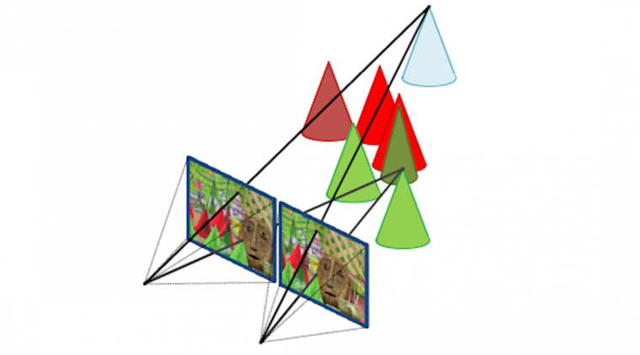
History[1-6]
PAPER
Introduced by Chris Harris and Mike Stephens in 1988
Improvement of Moravecs Corner Detector
Is used to find corner (and edges) in relation to image processing
Concrete application examples
Motion detection
Image stitching
Stereo vision
A COMBINED CORNER AND EDGE DETECTOR

Slide 5


Definition: Corner[1,7,8]
What is a corner?
(Wikip.) „intersection of two edges”
(OpenCV) „corners are regions in the image with large variation in intensity in all the directions”
Why do we want to detect a corner (and not an edge)?
Points of interests are easier to find when using a corner
5

Slide 6
Explanation of the Algorithm

Slide 7
Steps
Calculate Gradients
Structure Tensor Computation
Harris Respone Function
Visualizing the results

Slide 8
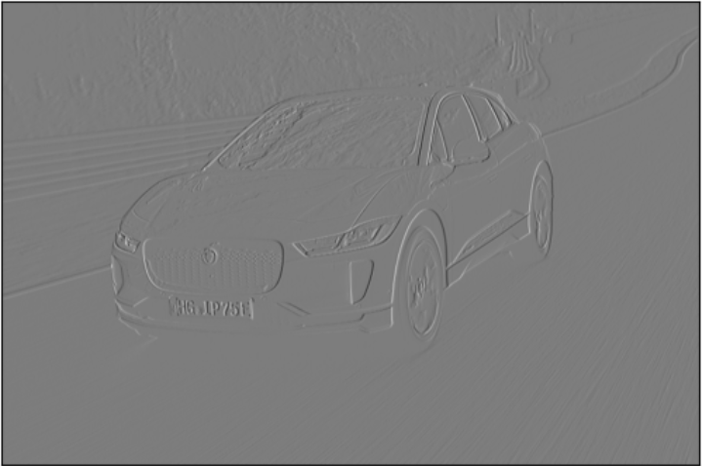

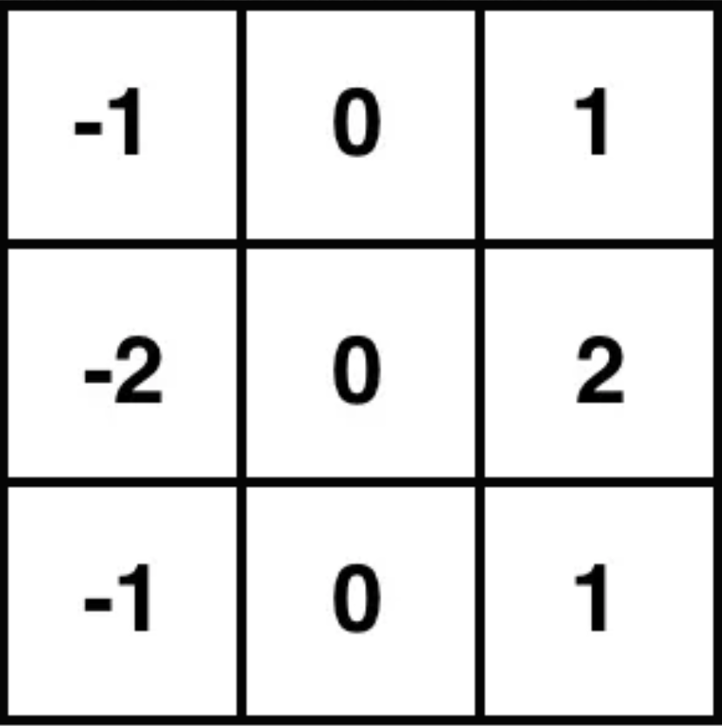
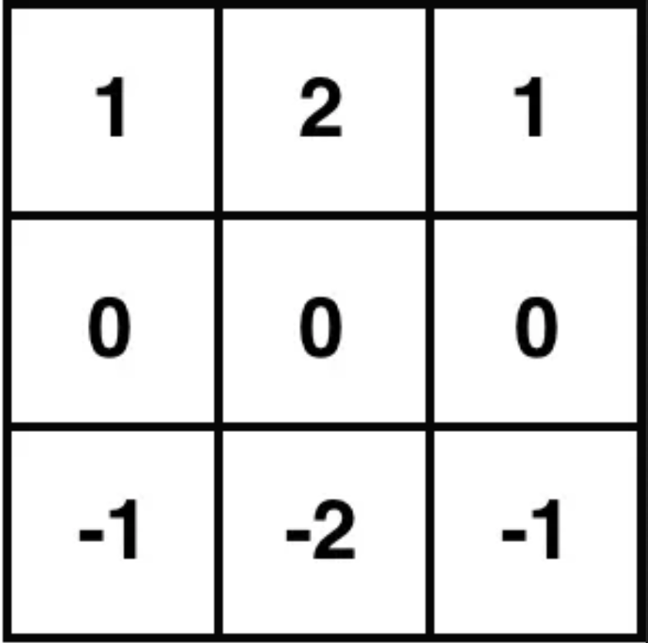
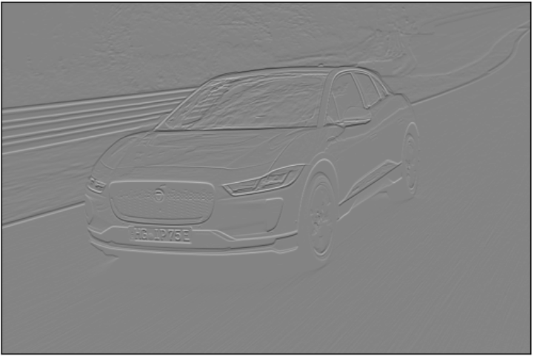
Step 1: Calculate Gradients[8]
Using Sobel:
Ix
Iy

Slide 9

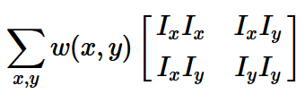


Step 2: Structure Tensor[1]
E(u,v)
Find intensity difference by displacing (u,v) in all directions:
Maximizing E(u,v) using the Taylor Expansion:
M

Slide 10



Step 3: Harris Response Function[8,9]
E(u,v)
Create a posibility score by using following equation
„penalizing parameter“
minder
Reminder „Eigenvalues“ => „Finding a vector v for a squared matrix A which, when multiplied by this matrix, returns itself as the result” => A * v = λ * v , where λ is the resulting eigenvalue

Slide 11
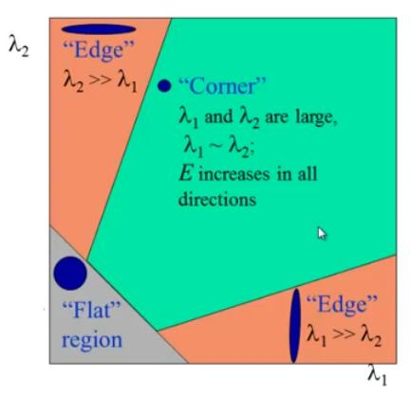
Step 4: Visualizing the results[8]
E(u,v)
Apply the trashhold parameters to the resulting score
|R| < 0
|R| >> 0
Small |R|

Slide 12
Thank you for your attention

Slide 13
Sources
Presentation
[1] https://en.wikipedia.org/wiki/Corner_detection#Moravec_corner_detection_algorithm (accessed 29.12.2024) [2] https://citeseerx.ist.psu.edu/document?repid=rep1&type=pdf&doi=88cdfbeb78058e0eb2613e79d1818c567f0920e2 (accessed 29.12.2024)
[3] TH Bingen WS2023: Dipl.-Phys. Michael Haag-Pichl – Computer Vision (PP-Slide 5, Side 14)
[4] https://forum.arduino.cc/t/motion-detection/402191 (accessed 29.12.2024)
[5] https://pyimagesearch.com/2018/12/17/image-stitching-with-opencv-and-python/ (accessed 29.12.2024)
[6] https://de.ids-imaging.com/technical-articles-details/whitepaper-depth-information-3d-images.html (accessed 29.12.2024)
[7] https://www.youtube.com/watch?v=bYzqUq6MFtc&t=666s (HAW Hamburg, accessed 29.12.2024)
[8] https://docs.opencv.org/4.x/dc/d0d/tutorial_py_features_harris.html (accessed 29.12.2024)
[9] https://studyflix.de/mathematik/eigenvektor-1634 (accessed 02.01.2024)
Code
(2x2 Matrice Trace Calculation) https://www.vcalc.com/wiki/SavannahBergen/Trace+of+a+2x2+Matrix
(2x2 Matrice Determ. Calculation) https://www.mathebibel.de/2x2-determinanten-berechnen
(Sobel Kernel Derivation) https://homepages.inf.ed.ac.uk/rbf/HIPR2/sobel.htm
(Harr. Corn. Example OpenCV) https://studyflix.de/mathematik/eigenvektor-1634 (accessed 02.01.2024)
(Basic Principal Explenation) https://www.youtube.com/watch?v=vgSmxhXXF_4&t=212s
13

